Slide 1
Anger
How to respond

Slide 2
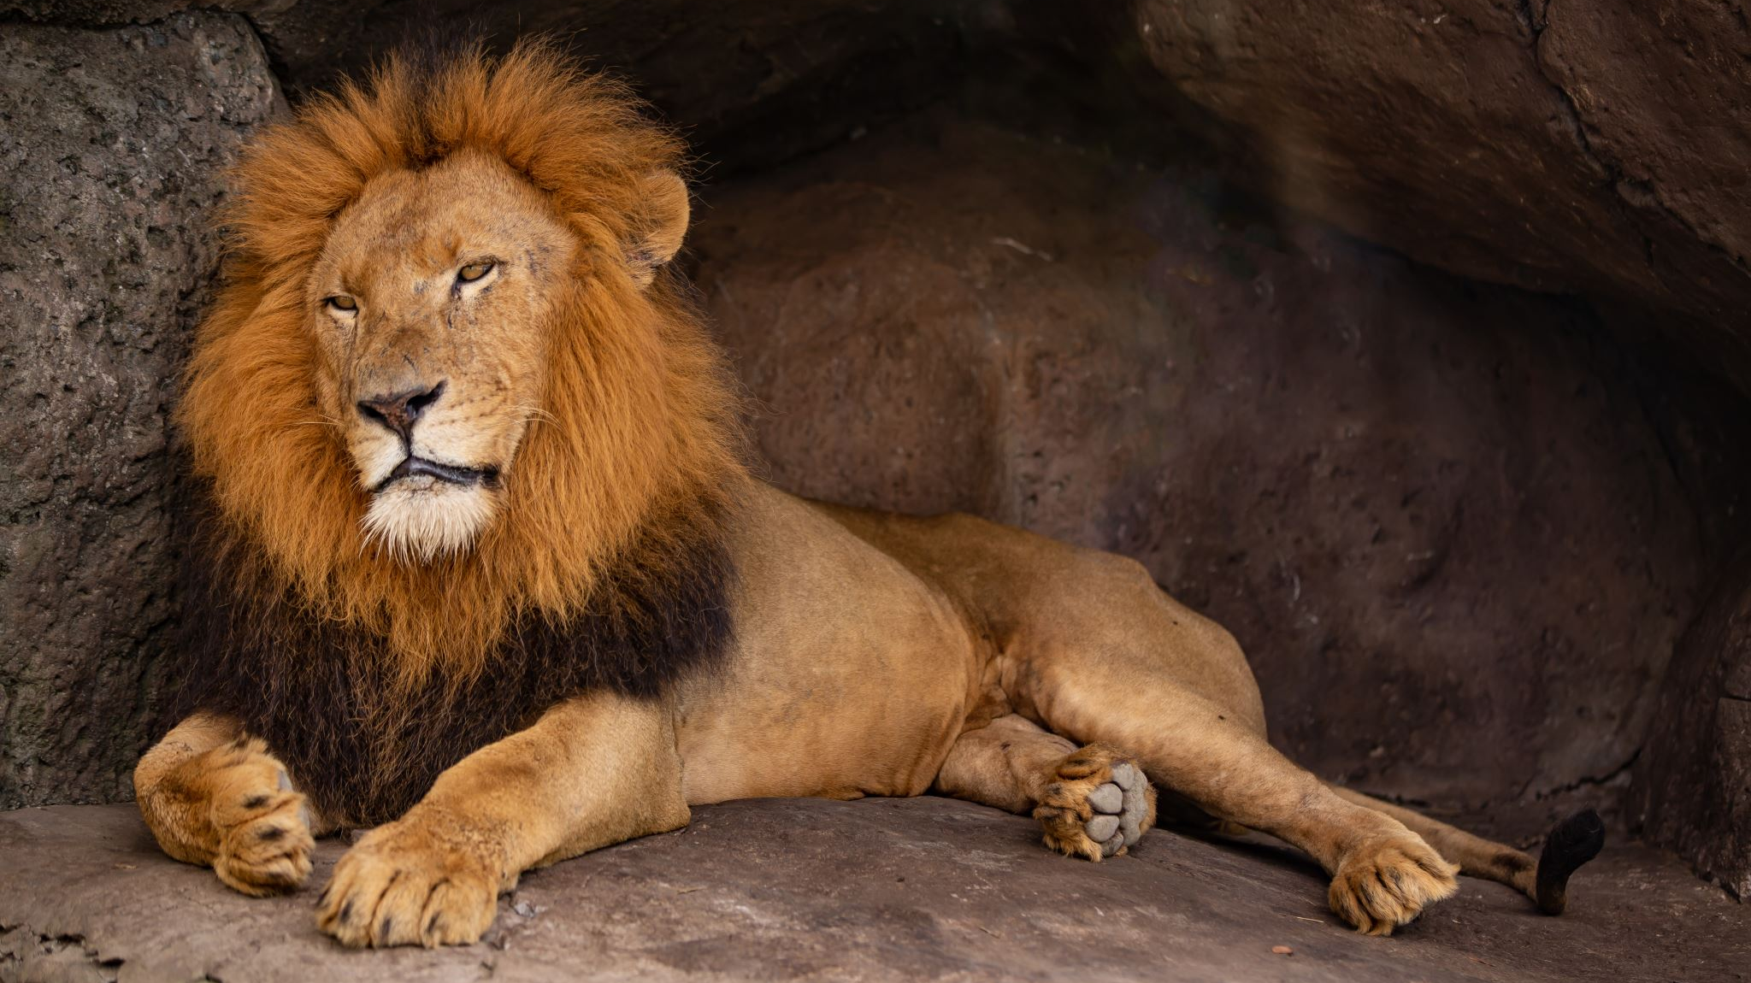
How do I ReCOgnise And MaNAge My Own Anger

Slide 3
Recognise Warning signs
Argumentative
Raised Voice
Increased heart rate
Quick to judge or “snap”
Teeth clenching
Tightness in chest
Increased anxiety

Slide 4
Why am I Angry
Carer burnout
Frustration at trying to help your child
Frustration at need to advocate for your child
Frustration at lack of services and support
Frustration that your child’s need to protect themselves mean they are hard to reach
Frustration that you seem to be doing this on your own

Slide 5
Why Is My CHILD ANGRY?
Feeling of worthlessness and inadequacy
Feelings of Shame
Lack of understanding of task – delayed cognitive understanding
Triggered to survival behaviour
Need for control
Protective mechanism –fighting to protect from hurt

Slide 6
Warning signs in my Child
Irritability
Controlling
Aggressive
Argumentative
Withdrawn
Refusing to do task
Defiant
Unwell/stomach ache
Self harming/ internalizing
ODD

Slide 7
How can I manage OUR ANGER
Recognise own anger first – Use self care strategies –Try not to argue back
Recognise child’s reaction is not at you but from a place of hurt and trauma
Count to 100
Deep breathing
Talk to a friend
Go for a walk
Remove yourself –sit outside , notice what’s around you
Recognise own feelings –I cant do this anymore , I am not good enough
Write it down – helps to externalize and can decrease importance on reflection
Once calm you are ready to support your child

Slide 8
How DO I Calm My CHILD
Validate and acknowledge
Validate and acknowledge feeling of being overwhelmed
Reassure
Reassure them that you love them and are there for them
Acknowledge
Acknowledge your own feelings of frustration
Aid
Aid them to self regulate
Give
Give them the right and safety to express feelings and sadness
Work
Work together to manage anger management strategies

Slide 9
How Do I Calm My Child
Actively Listen don’t problem solve
Try to maintain calm enquiring/ supportive voice
Use humour to help de escalate (where appropriate and when ready)
Role model with “I” statement for child’s benefit and not your own
Remember to always link back to “Am I Therapeutically parenting”
Assess what is working for your child in this moment and regroup if necessary

Slide 10
Strategies to help Calm
Identified safe “cooling down space”
Give them time to cool down
Chewy foods
Repetitive movements –bouncing a ball ,trampoline, boxing bag
Hanging ,swinging, climbing
Write down feeling – Externalize
Teenagers “ Music” “ Movies” “ Computer”
Exercise /Relaxation
Websites /Apps

Slide 11
Apps
Mood Mission
Mood Path
Pause
Self –Help for anxiety management
Stop, Breathe Think
Super Better

