Slide 1

Fears and Triggers
Presented by Liz Powell and
Sonia wagner 23/6/21

Slide 2
“The first fight is inside you.
That battle is overcoming your fears, steeling your resolve, maintaining an offensive mind set, developing skills, knowledge and personal power, and not succumbing to mediocrity.”
The Big 4 of Mental Toughness https://sourcesofinsight.com/3-fights/

Slide 3
Common Fears
Common Childhood Fears
- Dark
- Heights
- Spiders, Snakes, Bugs, Insects, Bees
- Being alone/ separation/ divorce parents/death
- Intruders
- Loud noises
- Imaginary monsters
- Needles, dentist or doctors

Slide 4

Responding to Fears
Unmet childhood emotional needs can result in problems later in feeling disconnected or alone.
Distinguish fear from caution eg snarly dog
Investigate the source of the fear. Be
honest and reassuring but not
overcompensating so that a skill is learnt
Talk about how you will work together for
them to master the fear by themselves,
one step at a time with them in control.
Teach them coping skills: read, turn on a
light, music, hallway light, hug then to bed,
investigate room with them, walkie talkies,
night 1 to night 4 plan.
Build their skills by asking questions like
“what makes dogs scary” or
“all dogs or certain dogs”
Recognise efforts and improvements
and allow for steps backwards.
Go at their pace.
Ensure routines are in place eg steps before bed may include brushing teeth, toilet, 3 books in bed, gratitude story, music, parent exit. The possibilities are endless!
Consider OOHC factors such as felt safety, speed to trigger, need for control, subconcious triggers.

Slide 5

Responding to Common Specific Fears
Needles/Doctors/Dentists
Discuss ahead of time
Deploy distractions at appropriate time
Model behaviour you want
Don’t mention pain, focus on outcome
Cough once before and once during
Insects, bugs, bees, spiders and snakes
Go over to them rather than removing them
Help them understand the bugs are looking for food in the same way as we are through sharing information
Have them adopt the bug or snakes life for a moment and consider how they go about their day eg spiders eat mosquitoes or are eaten by birds
Consider raising a cricket colony to aid understanding or catch a danny longlegs and consider safely while in a jar
Address misconceptions eg which are venomous, bees die after a sting
Perspective eg falling down hurts yet you still run so bee stings hurt but shouldn’t stop you from being outside
Separation Anxiety (babies 6 months+)
Take them with you
Tell them when you are leaving and announce when you return.
Reassure them with a calm voice and confident look.
Crying out makes it worse
Dark/Monsters/Intruders
Talk about it and reassure them they are safe.
Ask for suggestions on what would make them feel safe or safer eg toy to bed.
Consider showing them the locks and security.
Find out if the fear comes from another source eg worry about parent dying
Night light or lamp available next to their bed
Exercise during the day
Loud noises
give warnings before turning on loud machines
show them how certain items work eg vacuum up a tissue box, your hand over a bath draining
play games where they create loud noises eg bang on pans
have them create the specific noise that scares them (empowerment and understanding)
Death
lack cognition to perceive reality
listen, share, discuss and reflect
talk about your beliefs
avoid statements like grandma has left us
www.keepyourchildsafe.org

Slide 6
Ways to manage triggers
Responding to fears or tantrums in Public Places
Don’t use consequences when dealing with tantrums or meltdowns – they are out of control – be patient and calm.
Prepare a response – If you start getting frustrated or overwhelmed, let me know and we will take a rest before continuing.
Remind them of what you want them to do – accept no, calm voice not raised
Leave them at home if they cant handle something – let them know why.
https://www.empoweringparents.com/article/acting-out-in-public-is-your-childs-behavior-holding-you-hostage/
Look for anger triggers
- hunger
- tiredness
- stopping an activity they enjoy
- frustration (losing a game, low marks, waiting, raining, being told no)
- anxiety
- sense of justice (ignored, left out, cheating)
Identify which ones you can do something to avoid and which ones you cant. Plan!
https://www.empoweringparents.com/article/how-to-find-the-behavioral-triggers-that-set-your-kid-off/#:~:text=Once%20you%20identify%20your%20child's,inappropriate%20response%20to%20that%20situation

Slide 7

Specific Circumstances to Consider
Oppositional Defiance Disorder
- Wont do what they are asked to do
- Get angry and aggressive when asked
Shows symptoms very often, in a way that interferes with daily activities and for at least six months
Use rewards chart, praise, short specific instructions, choices, immediate consequences or followups
Consult paediatrician, psychiatrist or psychologist to develop a behaviour management plan
Autistic or Sensory Processing Disorder
Small disruptions to routines
Unfamiliar or unpredictable situations
Their own or others thoughts and feelings are unclear
Use calming strategies
Count slowly to 10
Deep breathing
Run around yard
50 star jumps or trampoline jumps
Look at special or favourite things
Read favourite book
Close eyes for a moment
https://raisingchildren.net.au/autism/health-wellbeing/mental-health/anxiety-asd

Slide 8
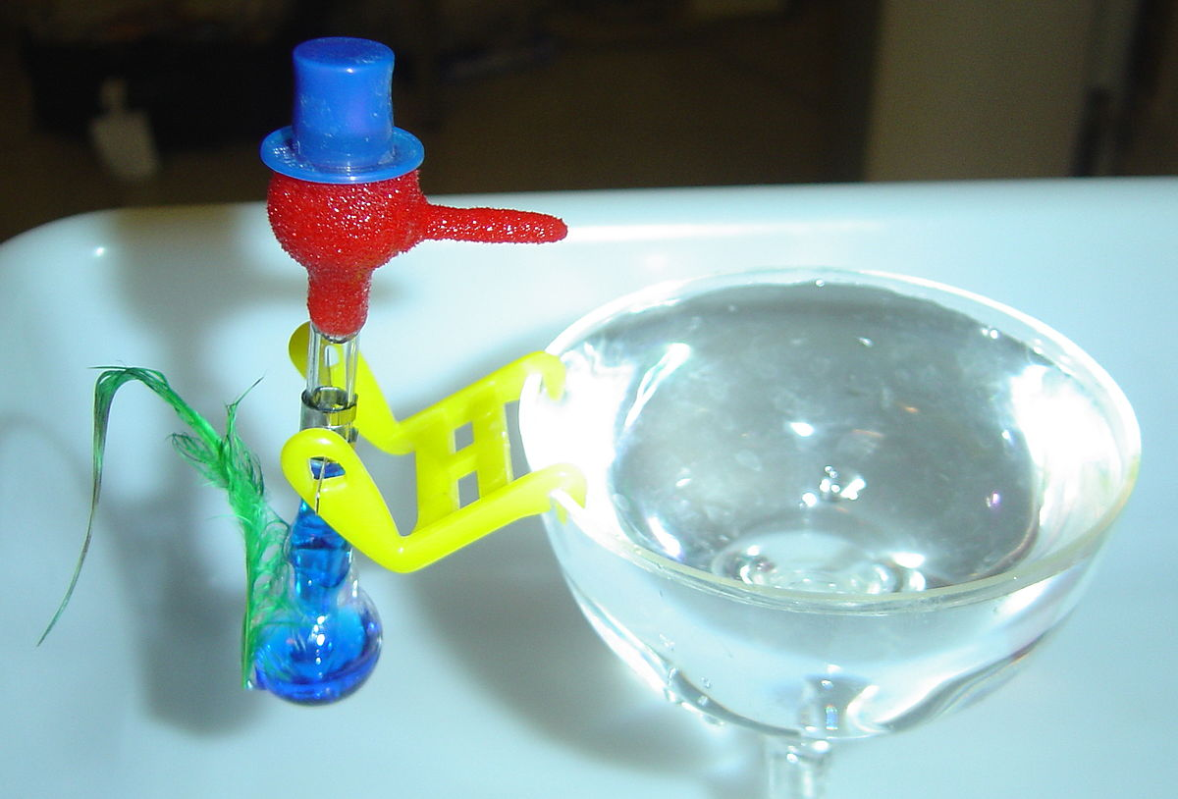
Persistent, Pervasive and Permanent to Transient, Situational and Specific
Triggers that transport one back to an original trauma
Activated by sight, sound, touch, smell and taste eg a father that resembles an abuser, alcohol related to an abuse, anger or pain, food or tobacco, touch or too close or
Anniversary of a loss (PC/KC/Adoption) or loved one
Frightening news events
Too much to do
End of a relationship
Too much time alone
Being judged, crticised, teased or put down
Harassment, violence or abuse
Illness, surgery or an accident
Being yelled at or treated aggressively
Smells, tastes or noises
Humiliating or disappointing experience
https://www.mentalhelp.net/recovery-and-wellness/triggers/
Likelihood of future trauma impacted when in an unstable or unsafe environment, separation from parent, serious illness, abuse or neglect or intrusive medical procedures.
Children can regress to earlier stage in life where they felt safe, think the event is their fault, have sleep disorders or feel helpless
Treatment
Co regulation, understanding and reconnection, neutrality, normalize, name the escalating signs
Berry Street – break in, breakout and build up model
Somatic experiencing/CBT/EMDRStepladder approach
Learnt phrasing and role plays
Social Stories or Social Skills Classes
Relaxation
Training
Medication
Journals
Time with friends
Exercise
Withdraw from activities
Disruptive behaviour
Compulsive behaviour
Panic attacks
Obsessive worrying / fixation

Slide 9
RESOURCES
https://www.betterhealth.vic.gov.au/health/conditionsandtreatments/fear-and-anxiety-children
https://childmind.org/article/help-children-manage-fears/
https://www.mentalhelp.net/recovery-and-wellness/triggers/
https://raisingchildren.net.au/autism/health-wellbeing/mental-health/anxiety-asd
https://www.empoweringparents.com/article/how-to-find-the-behavioral-triggers-that-set-your-kid-off/#:~:text=Once%20you%20identify%20your%20child's,inappropriate%20response%20to%20that%20situation
https://www.empoweringparents.com/article/acting-out-in-public-is-your-childs-behavior-holding-you-hostage/
www.keepyourchildsafe.org
https://sourcesofinsight.com/3-fights/
https://learning.berrystreet.org.au/sites/default/files/2018-07/Calmer-Kindergartens-Poster.pdf

