Slide 1


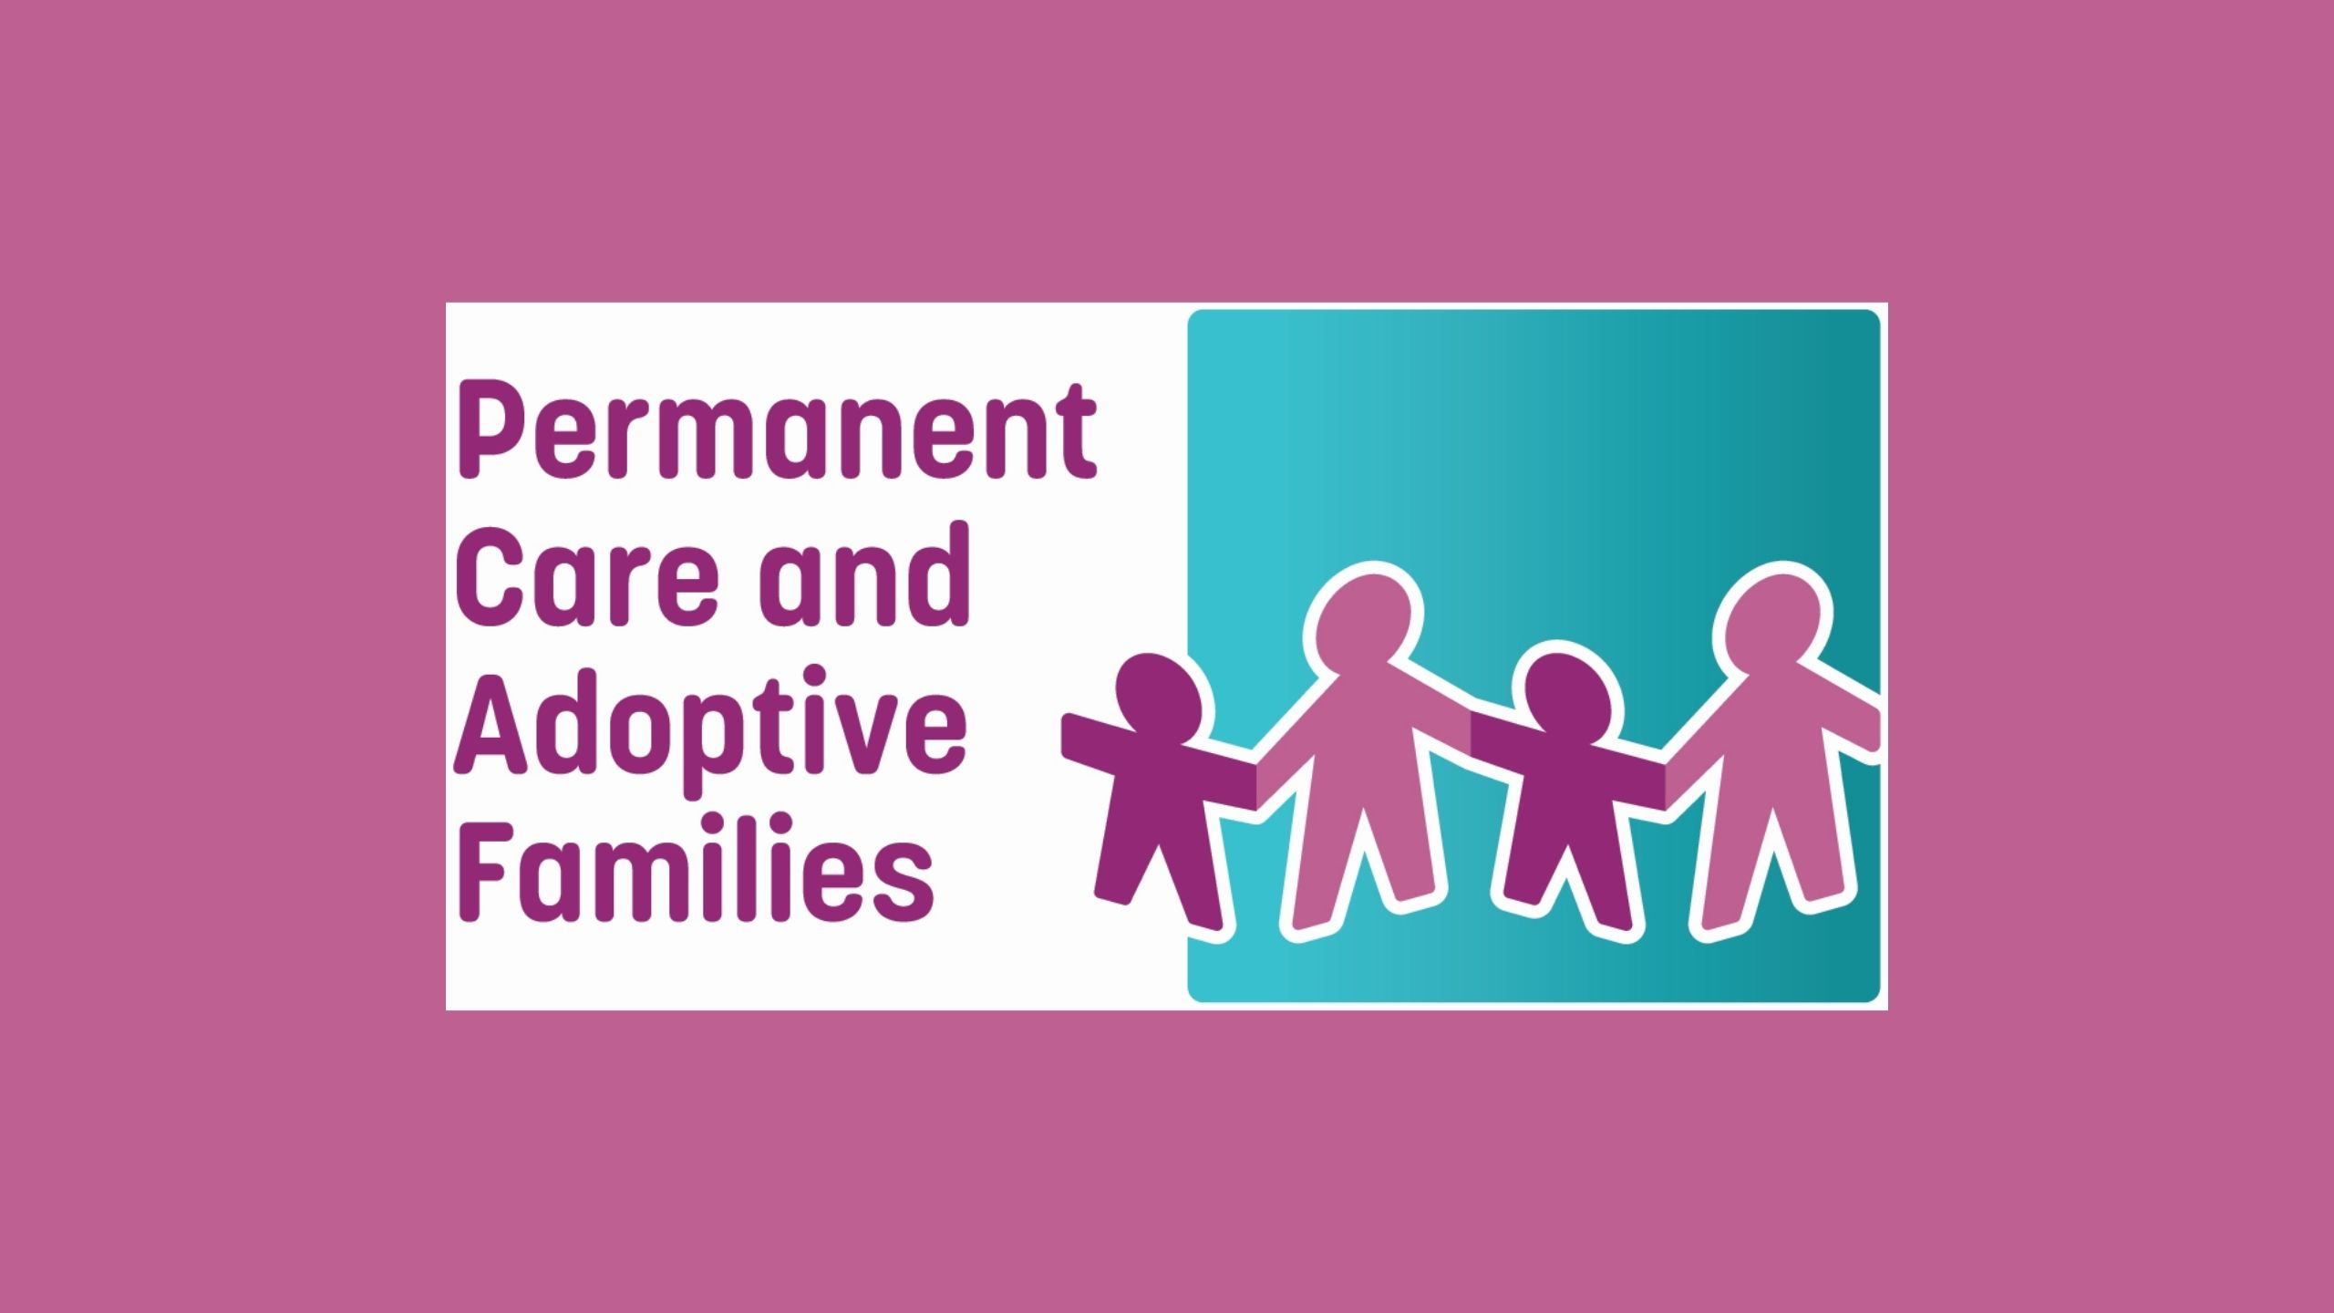

Risky Behaviours
Presented by Liz Powell and Sonia Wagner 26 May 2021

Slide 2
Risky Behaviours
Alcohol
Tobacco/E Cigarettes
Drugs
Sexting
Graffiti Vandalism
Truancy
Fights
Unprotected sex
Eating disorders
Self destructive →
Deeper problem →
Specialist

Slide 3
Understand
Teenage brain hardwired to test you cognitively
Don’t see the risk ahead of time: impulsivity
Peer pressure
15-16 years peaks
Hair, clothing, body art: expressing self
Defiant or attention challenged children more likely to engage in risky behaviours

Slide 4
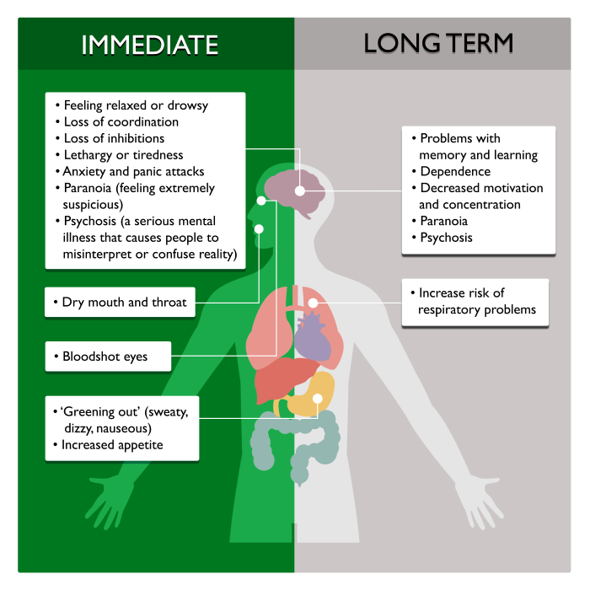
Drugs
Adults who have used any illicit drug 31%
Cannabis most common (12%), cocaine (4%) ecstasy (3%)
Experimental/Social/Situational to Intensive/Compulsive
Cannabis or party drugs (MDMA/Ecstasy): toxic substances, some contain no MDMA at all: 1 in 50 12-17yo have tried
Interventions need to target school (connection and peer factors) not just family or individual disconnection or dysfunction.
Risks
Addiction
Two to three times as likely to have a car crash afterwards: slows down thinking and reactions
Apps: Drug facts 4 young people (comic) Years 5-8
Video:
Effects of Cannabis on the Teenage Brain
Respect your brain: the effects of drugs on the developing brain
CANNABIS
https://positivechoices.org.au/teachers/cannabis-factsheet

Slide 5
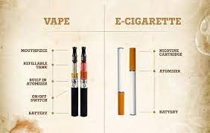
E-Cigarettes
Battery powered, heat liquids that are breathed in (nicotine, toxic chemicals, flavours)
Also called ENDS or ANDS, juuls or hookahs
Some look like pens or USB sticks
Risks
One pod = 4 days standard use = Nicotine equivalent whole pack of cigarettes
Recent outbreak lung disease and deaths in US appears e-cig related
Faulty parts and flammable batteries and swalling poison (can lead to death)
Laws
Illegal to use in cars with those under 16 years of age
Illegal to sell buy or use nicotine (exceptions via docots or for therapeutic reasons). Illegal to sell e cigs to <18yo
https://www.rch.org.au/kidsinfo/fact_sheets/E-cigarettes_and_teens

Slide 6
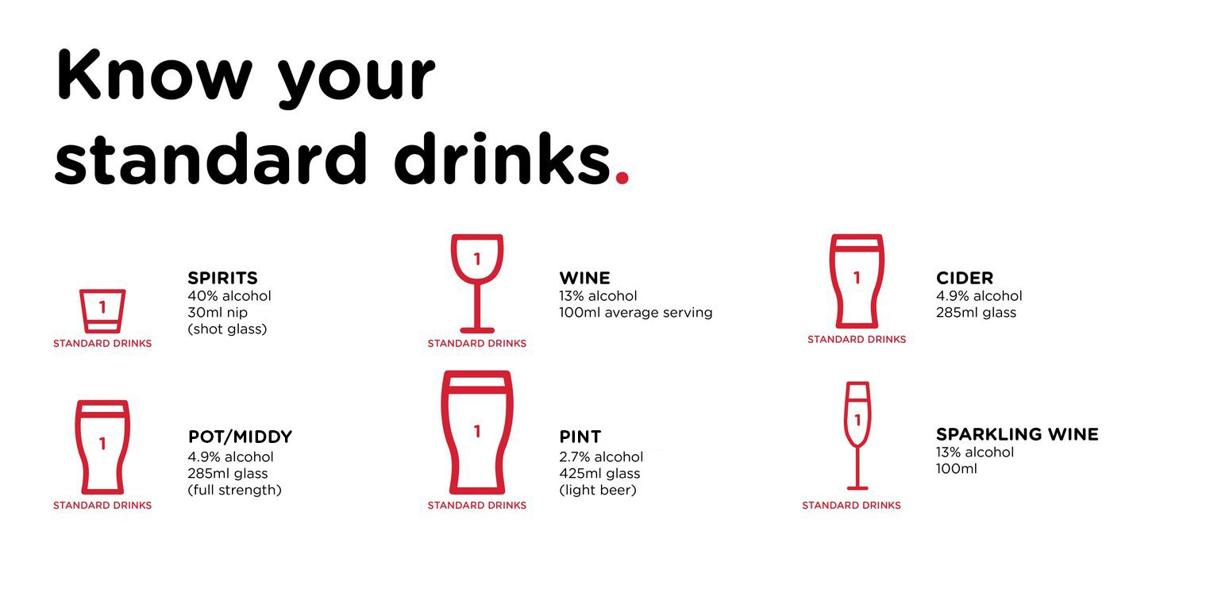
Alcohol
Usage among young people has declined since 2009, initiation age 16.2
83% of young people 14-19yo report being injured as a result of drinking
There is no safe level of drinking due to potential affects on the brain (pre 25) and long term related harm risks (long term consumption linked to cancer, cardiovascular and liver disease)
Risk Minimisation:
drink 1 glass of water for each glass of alcohol
eat before drinking
don’t leave drinks unattended
unlawful to give or to buy for under 18yo without parental consent - penalty 60 units (60 * $165.22 = $9,913)
unlawful for young person under 18 to be on licensed premises – penalty 5 units (5 * $165.22 = $826)
make a plan for safety with friends and stay with them if intoxicated, turn them on the side (pillows) and call 000 if necessary (confidential)
Apps: Alcohol and your brain
DARTA: Paul Dillon training in schools and parenting books: Teenagers, Alcohol and Drugs
Hosting a teenage party guidelines: https://adf.org.au/talking-about-drugs/parenting/talking-young-people/safe-partying/hosting-teenage-party/
https://www.nhmrc.gov.au/about-us/publications/australian-guidelines-reduce-health-risks-drinking-alcohol
https://adf.org.au/talking-about-drugs/parenting/talking-young-people/alcohol-young-people/

Slide 7

Graffiti
z
Risks
Marking private property $40,000 / 2 years prison
Spray paint can near public property, on spot $800
Graffiti implement $4,000
Criminal conviction
14-17 year olds can get searched
Act appliles to 10yo+
Offenders mid to high level income 15 years old
Risk Minimisation
Secretly search bags if suspect something

Slide 8
How to keep them safe
Connection and communication are key: let them know you care and come from a place of careAgree rules, but negotiate with active listening: they need to decide
Invite their friends over and get to know them
Safety plans, including friends and wider networks
Discuss peer pressure, values, behaviours and consequences
Encourage risk taking in sports, arts, volunteering or education
Let them know it ok to say no and trust their instincts – surprising how many don’t know this
Apps on phones to make prank calls to them to remove themselves from bad situations
Role play how to say no: I feel unwell, Oh my parents are picking me up, my Auntie is unwell

Slide 9
Resources
Teenage risky behaviour: a guide | Raising Children Network
Risk-taking and teenagers - ReachOut Parents
Effects of Cannabis on the Teenage Brain - Positive Choices Teenage Brain
Animated videos showing the effects of alcohol, cannabis & MDMA. - Positive Choices Respect Brain
http://darta.net.au/ Alcohol
https://adf.org.au/drug-facts/alcohol/ Alcohol and Drugs
https://www.nhmrc.gov.au/about-us/publications/australian-guidelines-reduce-health-risks-drinking-alcohol Alcohol
https://www.rch.org.au/kidsinfo/fact_sheets/E-cigarettes_and_teens ECigs and Tobacco
https://www.esafety.gov.au/ Sexting and Esafety
Graffiti schools education - Warner Youth Education - Graffiti Education – YouTube
Graffiti laws and information - Laws and penalties for graffiti vandalism | Community Crime Prevention Victoria

