Slide 1
Social and emotional resilience
Presented by Liz Powell and Sonia Wagner
Click and Connect, 8 June 2021

Slide 2
Social and emotional resilience
Resilience is a muscle that needs to be flexed!
Its not always what people see
It’s the work in the background and actions despite fears
Bouncing back from broken to face situations

Slide 3
Schools of thought
https://www.youtube.com/watch?v=0SauNUEw_OU
Success 1:30

Slide 4
Key DRIVERs
Learning through experience
Talk about feelings
Avoid fixing, predicting, preventing, shielding and avoiding: ask questions
Recognise efforts not outcomes
Encourage second goes and jump in the puddles
Be kind to self
Create positive mindset dialogue eg positive thing or who you helped each day

Slide 5
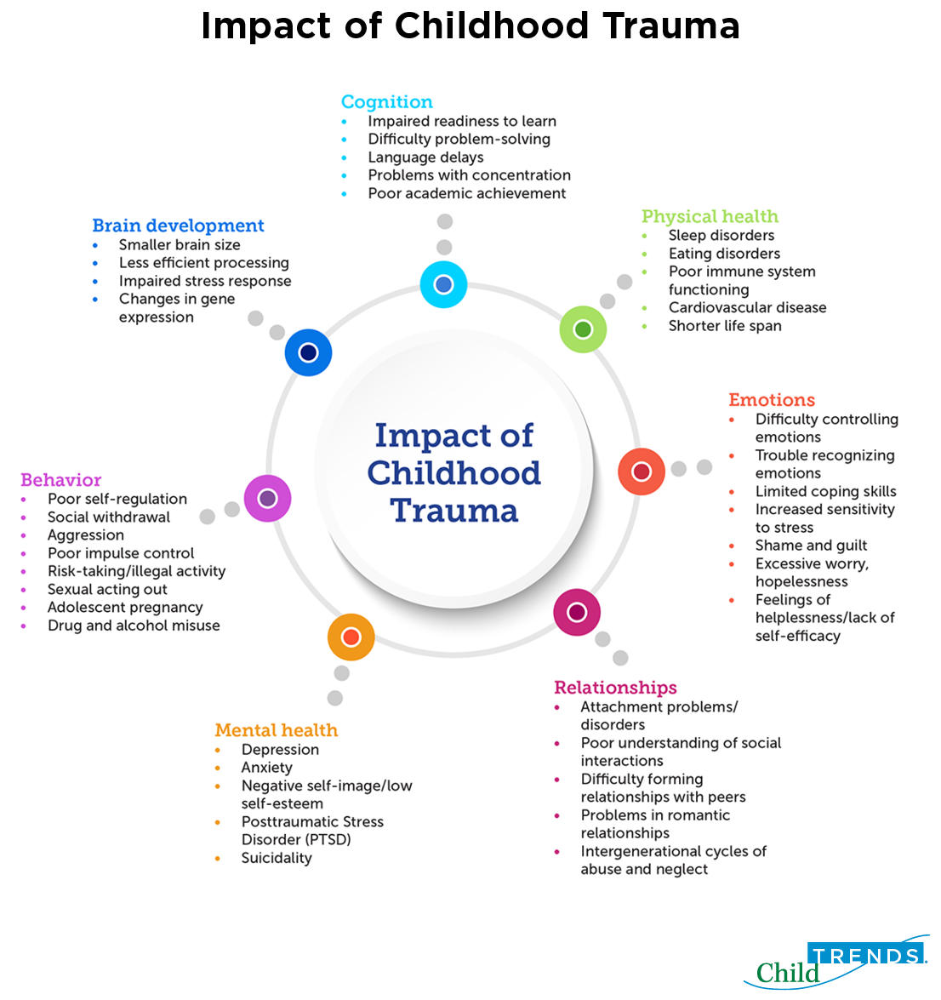
Definitions

Slide 6
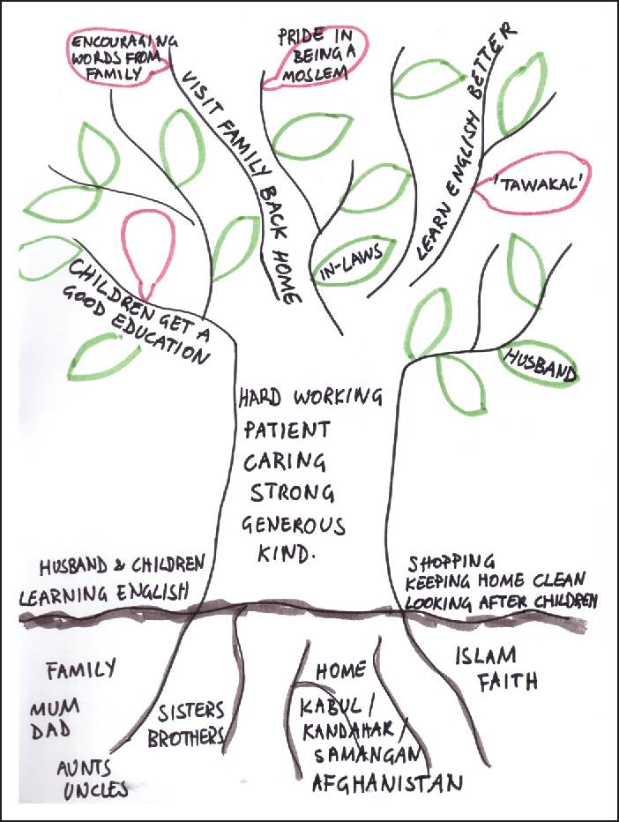
Resilience after trauma
Support from parents, friends, family, school and community
Feeling safe at home, school and in the community
Positive sense of self and self worth
Self-efficacy
Meaning
Adaptive and coping skills
Talent
Strong emotional connection
Strengths family tree

Slide 7
PARENTING practices
Promote healthy risk taking: bushwalk, rockwalk, start conversation, new activities
Brainstorm don’t problem solve
Label emotions
Demonstrate coping skills
Embrace mistakes
Go outside exercise and nature
Therapeutic, positive, trauma informed parenting
Self care

Slide 8
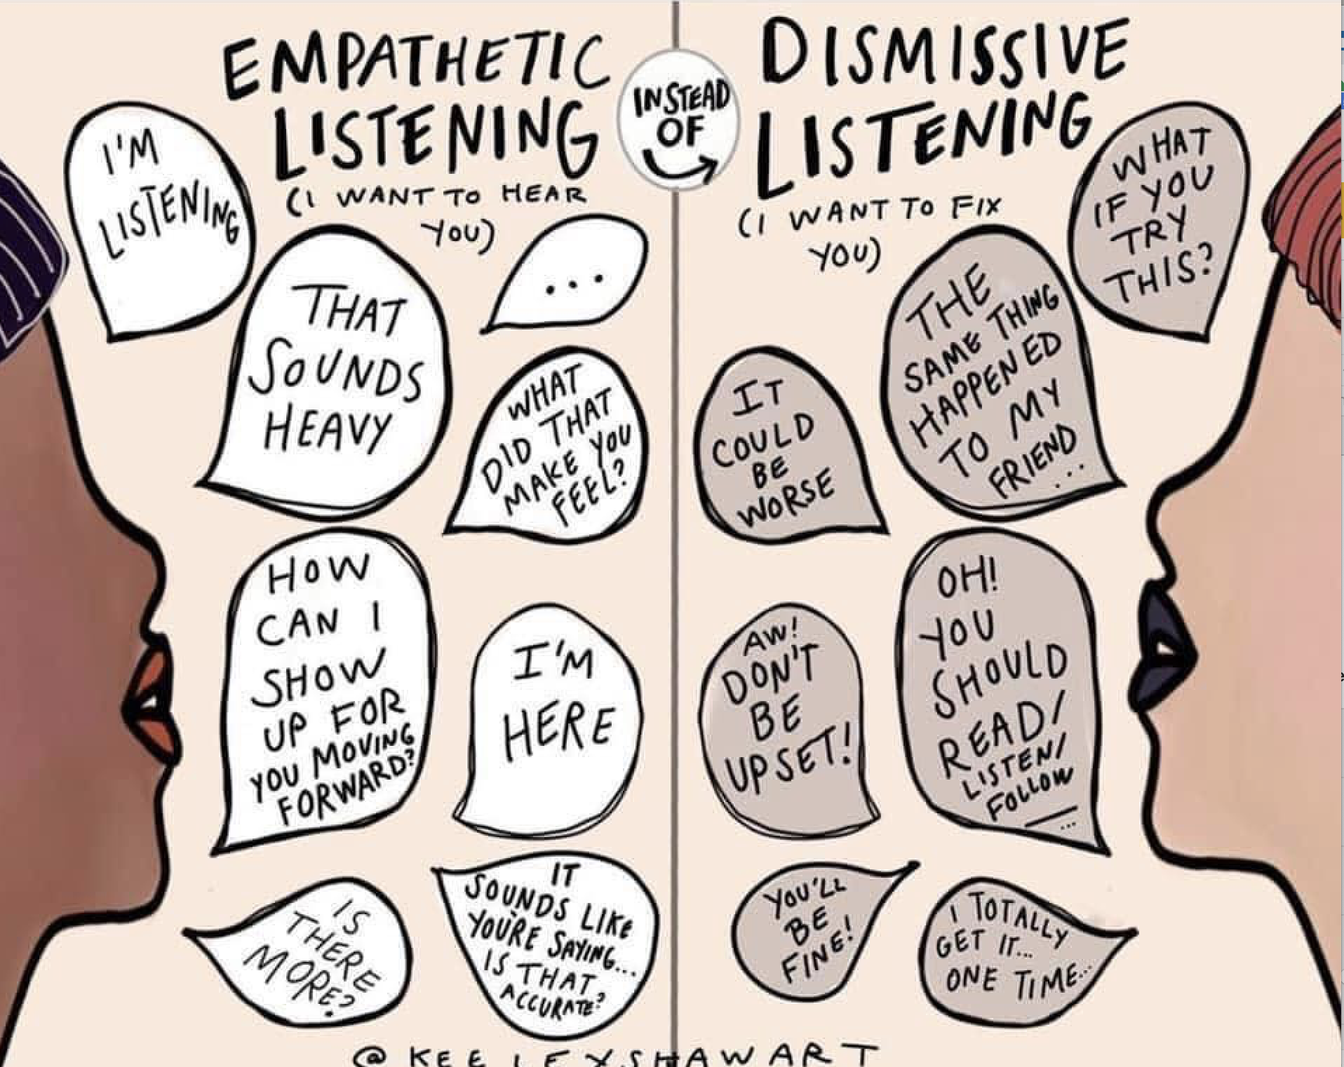
Practice your skills

Slide 9
Pandemic times
Fears about the pandemic
Remain calm
Honest descriptions but avoid media
Tune in to figure out and work through fears
Connections: increase 1:1 time, Uber Wednesdays
Share feelings
Share good news
Routines
Avoid anxious talk: strong tramsmission of anxiety from parent to child independent of genetics
https://www.psycom.net/internalized-anxiety-children/

Slide 10
From resilience to people magnet
Respect others opinions and feelings
Listen to others, hear and validate
Engage with others
Don’t brag or boast
Be confident
Think positively
Focus on a goal
Present self with smile, shoulders back, chest up
Good hygiene and clothes that complement self

Slide 11
resources
PROGRAMS
https://raisingchildren.net.au/school-age/behaviour/understanding-behaviour/resilience-how-to-build-it-in-children-3-8-years
https://www.nctsn.org/sites/default/files/resources/resilience_and_child_traumatic_stress.pdf
https://www.childtrends.org/publications/how-to-implement-trauma-informed-care-to-build-resilience-to-childhood-trauma
https://resources.beyondblue.org.au/prism/file?token=BL/1810_A
Shine Academy for Girls
Longford and Fraser Academy for Boys
Green Super Camps
EmotionWise

