Slide 1
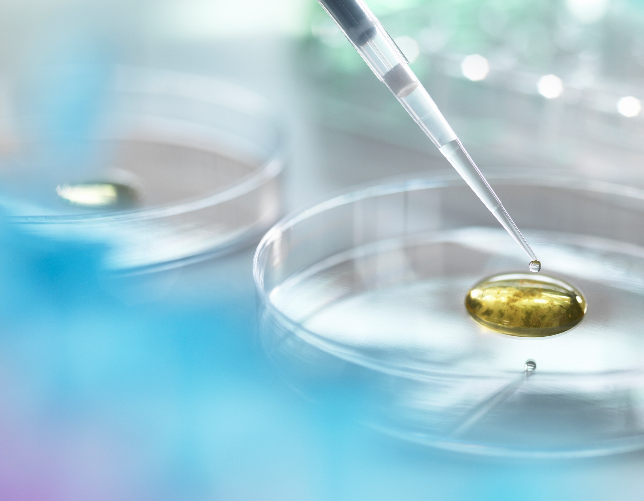
Self-regulation (AND TRAUMA)
Presented by liz Powell and Sonia wagner pca families 12/5/21

Slide 2
Self-regulation
The ability to understand and manage your emotions, thoughts, reactions, feelings and behaviours to things happening around you.

Slide 3
Understand it
ITS NOT BEING NAUGHTY OR SEEKING ATTENTION
Relate this to how you manage with lack of sleep
Reactions slow down
You do less
Your brain changes your body’s response.
Children with trauma (emotional, psychological, physical or social), protect themselves: brain on high alert, using up energy that often results in flight, fight or freeze response and the outsourcing of self regulation (to parents, carers, teachers).

Slide 4
SIGNS of poor self regulation
Trauma Impact Fact Sheet trauma affects the brain
Emotions
Sad or emotionless states. Don’t feel empathy or sense of right and wrong.
Reactions
Hair trigger response to a stress. Problems regulating anger, fear, sadness, loneliness and shame.
Thoughts
Misread facial expressions or friendly remarks.
Anticipation
Trouble anticipating consequences and risks.
Behaviours
Prone to withdrawal or aggression.

Slide 5
What does that mean for them
May have challenges:
Learning at school
Behave in socially acceptable ways
Making friends
Managing stress
Becoming independent
www.raisingchildren.net.au

Slide 6
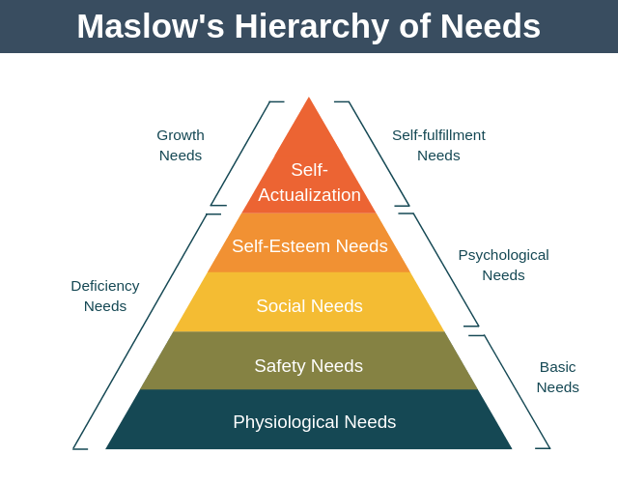
The fix?
Theory of Human Development where individuals move through basic needs before they achieve self actualisation.
Safety and Security after food, water and warmth.

Slide 7
What to do
It is a skill to be taught: scaffold the learning as a coach
  If the skill is to stop playing a video game, have them start practicing handing over control to you on a game they are not overly invested in
  If the skills is to brush their teeth, start with just getting paste on the brush, respond positively
  If the skill is to get up in the morning, start with getting dressed, no breakfast
Provide for a safe and secure home with rich experiences to stimulate brain growth
  Stay with me, don’t leave, keep me close, match my energy, tell me you love me, give me blankets and comfort, gently recognise my challenges, watch I don’t remove myself or just blindly agree, connect with me and empathise, tell me about changes and listen and acknowledge me.
Develop their understanding through warm and responsive relationships
  Trust Based Relational Intervention (a neurological intervention addressing Physical Needs, Connecting and Correcting Principles which address attachment and disarm fear, Dr Karyn Purvis (https://child.tcu.edu/about-us/tbri/#sthash.bi80YkNs.dpbs)
Self-regulation

Slide 8
What to do
Support your own understanding of the link between trauma and cognitive difficulty eg programs
Support them in becoming aware of and able to express their emotions. Self reflection
  Holiday camps can help with this eg Greens Super Camp, Shine Academy or Longford and Fraser Academy
Encourage them to become stress detectives to identify and reduce triggers or stresses
Help them learn what it means to be calm. Apps can help: Smiling Mind, Breathe, Headspace
When they become agitated, treat it as a learning experience and help them learn what helps them calm down
Build and mend broken relationships quickly
In schools, align to TBRI principles or consider alternatives: Move, Work, Breathe, Life Skills Group, Smiling Mind, Second Step or Peaceful kids
Self-regulation

Slide 9
TRAINING PROGRAMS – FOR PARENTS
TBRI
Parent Child Interaction Therapy
Parent Management Training
Defiant Teens
Therapeutic Parenting
Positive Parenting Program (Triple P)
Tuning into Kids or Teens
The Incredible Years
Behavioural and Emotional Skills Training

Slide 10
TRAINING PROGRAMS – FOR KIDS
Cognitive Behaviour Therapy
Dialectical Behaviour Therapy
Green Supercamp
Shine Academy for Girls
Longford and Fraser Academy for Boys

Slide 11
RESOURCES
RAISINGCHILDREN.NET.AU
CHILDMIND.ORG
COECT.CO.UK
CHILD.TCU.EDU
AIFS.GOV.AU
  https://aifs.gov.au/cfca/publications/effect-trauma-brain-development-children
BEACONHOUSE.ORG.UK
  https://beaconhouse.org.uk/wp-content/uploads/2020/02/Developmental-Trauma-Close-Up-Revised-Jan-2020.pdf
SELF-REG-CA
  https://shop.self-reg.ca/collections/online-courses/products/self-reg-parenting-course

