Slide 1

Sensory Processing
Presented by Liz Powell and Sonia Wagner
14 July 2021

Slide 2
What to look for
Light or noise aversion
Feel of clothing, tags or shoes
Balance and coordination or clumsiness
Fine motor skills eg buttons
High or low pain threshold
Water on the face
Mood Swings
Tantrums in changing environments
Fight or Flight
Body Awareness
Crave motion
Cover ears
Food textures
Affects 1 in 6

Slide 3
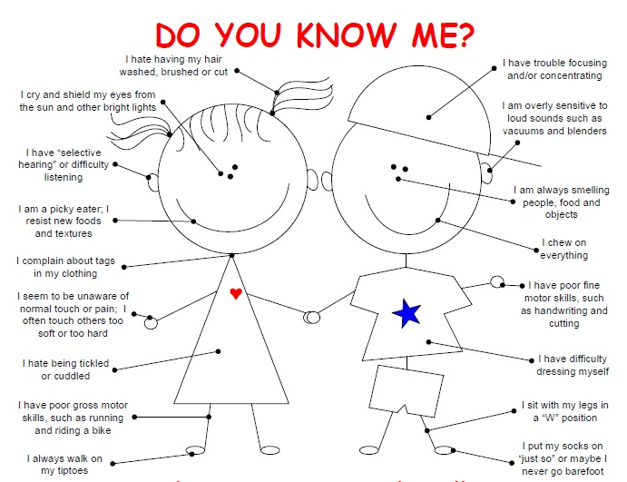

Sensitivities

Slide 4

Diagnosis
Undertaken when symptoms disrupt everyday life (generally toddler years 2+)
Trouble taking in information from senses eg oversensitive, undersensitive
Not a recognized disorder in Australia
Other signs
  Anxious in unpredictable environments
  Wants to know the plans for the day ahead of time
  Gets tired in busy environments
  Has trouble going to sleep and staying asleep
  Avoids tasks that involve senses eg feeding
GP will refer you to a specialist (Occupational Therapist, Psychologist or Paediatrician)
Specialist will assess with your input and face to face observation
Resources might help (see below)
Disruption can present as sensitivity

Slide 5

Intervention
Behaviours can be isolating
Therapy eg speech development, occupational therapist intervention, social, emotional and behavioural (psychologists and social workers)
Early childhood educators and school teachers
Parent or Family Based Workshops
  Hanen more than words or Hanen talkability
  Life Skills 4 Kids parent training to support sensory anxiety
  Communication and autism webinar or workshop
Kids Matters
Life Skills 4 Kids Tip Sheets –
  Mouth Tools for Concentration
  Fussy Eaters
  Fine Tuning Sensory

Slide 6
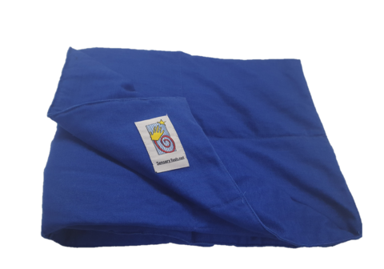
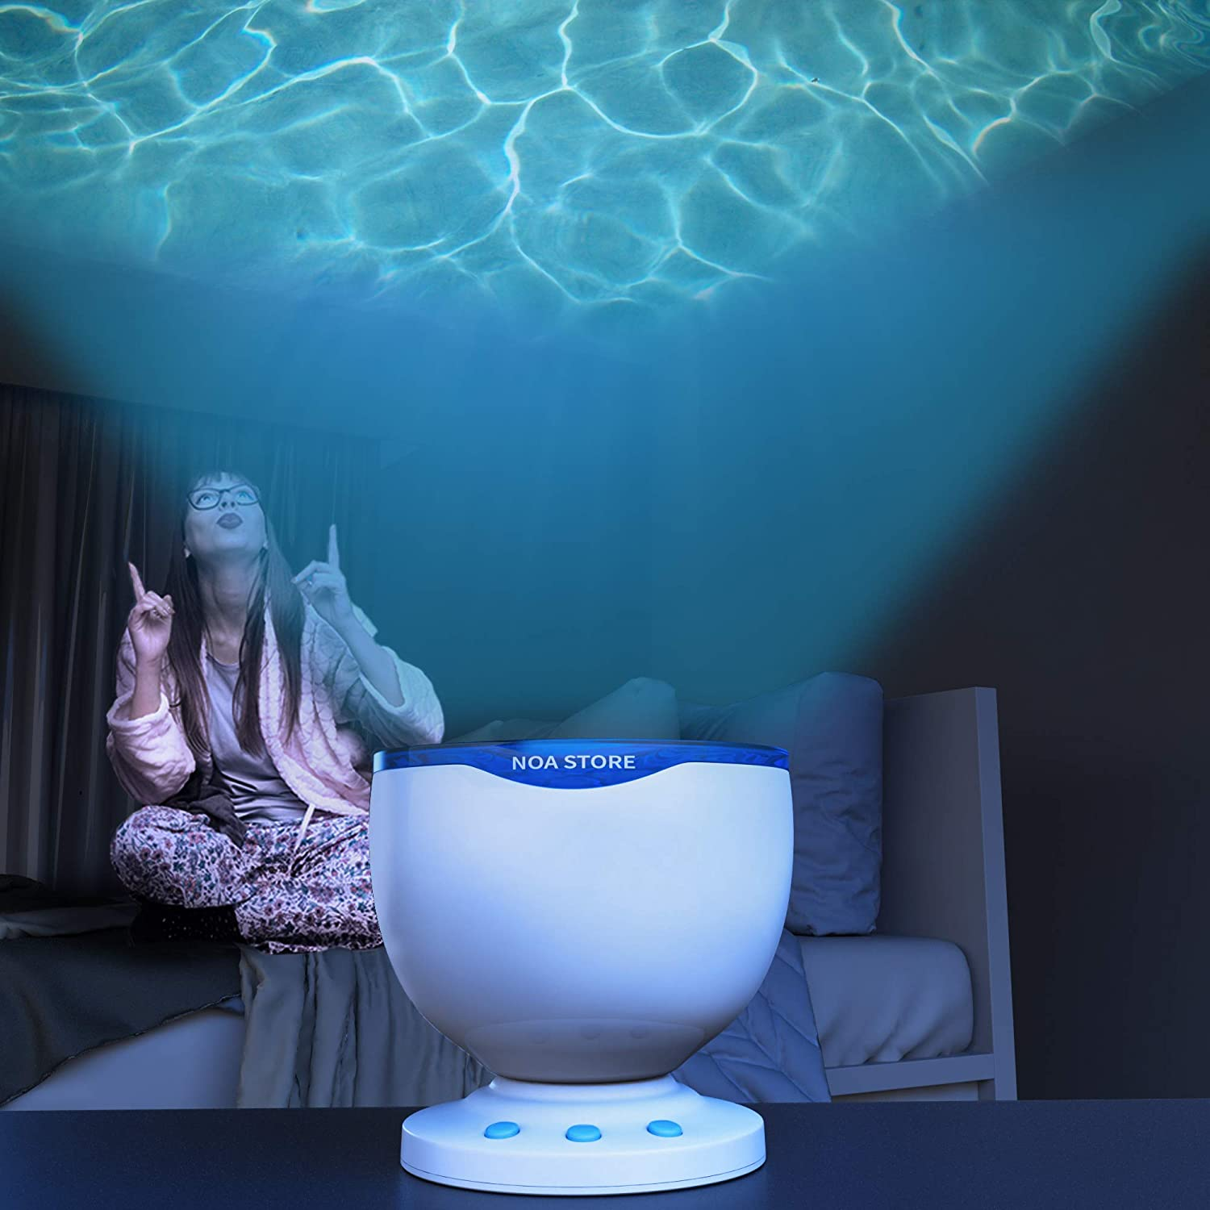
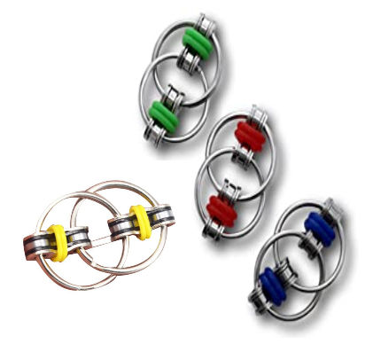
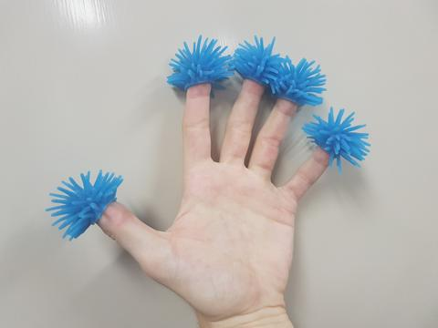
Equipment
Kloud Sac Sensory foam filled bean bags
Sensory calming projector light blue light and waves
Create a Sensory Room eg crash mat, swings, ball pits, movable surfaces, music and rhythm
Sensory Play activities eg water, sand, cornflour, travel kit
Craftercise classes to immerse children in sensory play activities
Craftercise kits eg farm, construction, sea life
Sound blocking headphones
Deep pressure vests or singlets or fidget toys (finger toppers) and more eg one way straws, chewy necklace, ezy lace ups, fidget ring, lap blanket, diffuser, sleep or anxiety spray (eg herbal)

Slide 7

Strategies
Your child as your boss: have fun
Visual schedules
Timers
Ipads
Routines and predictability and structure
Celebrate small steps

Slide 8
Sensory Diet - Pathfinders for Autism
Auditory (hearing): Sound sensitivity
1. Use various types of music/sounds, e.g. sound machines, classical music, Gregorian Chant, spa music
2. Provide noise cancelling headphones, ear plugs, ear muffs, cotton balls (being very judicious, don’t over use, only when absolutely needed)
3. Bring small sticky notes to cover automatic flush in public bathrooms, to delay flush response
4. Therapeutic Listening program
Tactile (touch): Have children play with a variety of sensations:
1. Dry beans, pasta, rice, sand
2. Work with silly putty, play dough, shaving cream
3. Water play, with different types of soap – scented, texture, etc.
4. Use gloves if your child is too sensitive to touch, to gradually desensitize them
5. Use a timer to “time limit” activity to help the child persist, knowing there is an end in sight
6. Deep pressure brushing, “Wilbarger Protocol”, combines brushing with joint compressions, taught by a therapist, to be followed throughout the child’s day.
Vestibular (balance & movement) & Proprioception (body position)
1. Provide opportunities to enjoy playground activities, swings, ladders, jungle gyms
2. Balance beams, balance circles
3. Animal walks, army crawls, wall and chair pushups
4. Simon says, follow the leader games
5. Heavy work activities, weighted blankets, vests, backpacks, fanny packs, no heavier than 10% of their body weight
6. Pushing medicine balls through a tunnel, carrying heavy balls through an obstacle course
7. Stacking chairs, cans, books
8. Pulling/pushing heavy objects, wagon activities
9. Wiping down windows, tables, chalk boards, cars
Visual (sight):
1. Reduce visual stimuli around the child.
2. Add color coding, darker outlines, etc. to homework
3. Provide extra visual stimuli with the use of glitter pens to draw attention
4. Allow use of sunglasses and a hat with a brim outside
5. Provide a study carrel in school to block out distractions
6. Allow preferential seating, head of class room, away from windows.
Olfactory & Gustatory (taste & smell):
1. Experiment with crunchy foods, e.g. apples, celery, hard bagels, pretzels
2. Try sucking thick liquids, milkshakes, kefir, through a straw
3. Blowing activities, blow pompoms across the room with/without a straw, blow bubbles in the sink filled with dish detergent, blow bubbles, blow out candles, blow toys, whistles, wind chimes
4. Tongue exercises in front of a mirror – try to touch your nose with your tongue, make circles with your tongue, touch each side of your mouth
5. Make funny faces in front of a mirror
6. Allow your child to put their favorite perfume on their shoulder, on a hair tie on their wrist, special beads to “smell” when needed
7. Use coffee beans to smell to “erase” unwanted smells.
8. Allow your child to carry scented hand cream to use after the bathroom

Slide 9
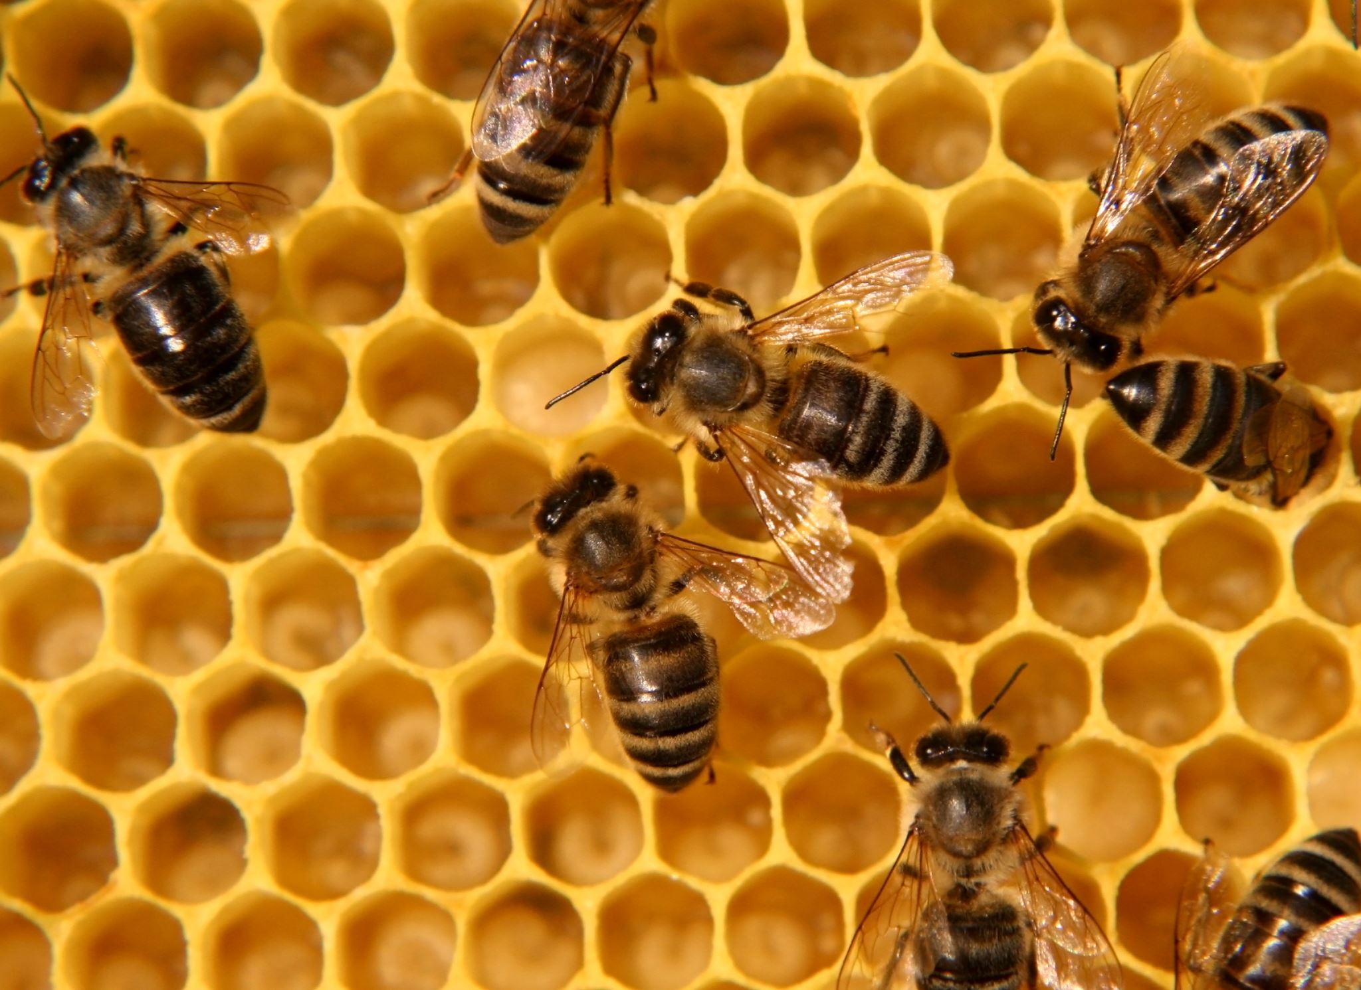
Fun Facts: Super Senses in Animals
Dogs are twice and Cats three times more likely to perceive sounds than humans
Mice have about 4 times the number of smell receptors, sensing more odors than humans
Bees can detect wavelengths of light outside human range

Slide 10
Resources
Child Mind Institute
Sensory Checklist
Autism Spectrum Australia
Raising Children Network

